Slide 1
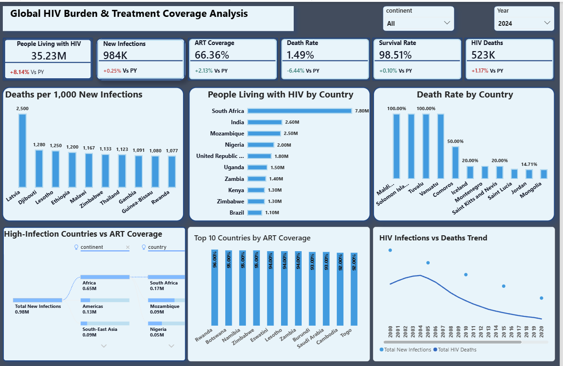
GLOBAL HIV TRENDS AND TREATMENT
EFFECTIVENESS ANALYSIS
Capstone Project POD 3
Specialization: Healthcare
Tools Used: Power BI
Data: WHO HIV FROM 2000 - 2024

Slide 2
Business Background & Problem
Objective
This project analyses global HIV trends, treatment access, mortality, survival rate, and country-level risk using Power BI. The aim is to understand whether infections and deaths are declining, whether ART coverage improves survival, and which countries require urgent intervention.
Public health focus
HIV burden, treatment effectiveness and country-level intervention priorities.
Analytical focus
Time-series trends, KPI development, country ranking and treatment access comparison.
Decision value
The dashboard helps translate complex health data into insights that can guide resource allocation and policy decisions.

Slide 3
Problem Statement
Core challenge
Although HIV-related data is available, decision-makers need a clean dashboard that connects infections, deaths, treatment coverage and survival outcomes in one place.
Stakeholders need a unified analytical view to:
Track HIV infections and deaths over time.
Measure treatment coverage across countries.
Understand mortality and survival outcomes.
Identify high-risk countries with poor ART access.
This limits strategic planning and targeted intervention when data is fragmented or difficult to interpret.

Slide 4
Data Description
Country
Geographic location where HIV data was recorded.
Year
Annual time dimension used for trend and YoY analysis.
Indicator
Metric type: infections, deaths, PLHIV, or ART coverage.
Value
Numeric measure: count values or treatment percentage.
Indicators analyzed
Data characteristics
Measures disease spread / incidence
Multi-country
Time-series
Aggregated annually
Supports trend analysis
country ranking and
treatment Coverage comparison.
New Infections
HIV Deaths
Measures mortality impact
People Living with HIV
Measures disease burden / prevalence
Measures treatment access and healthcare effectiveness
ART Coverage (%)

Slide 5
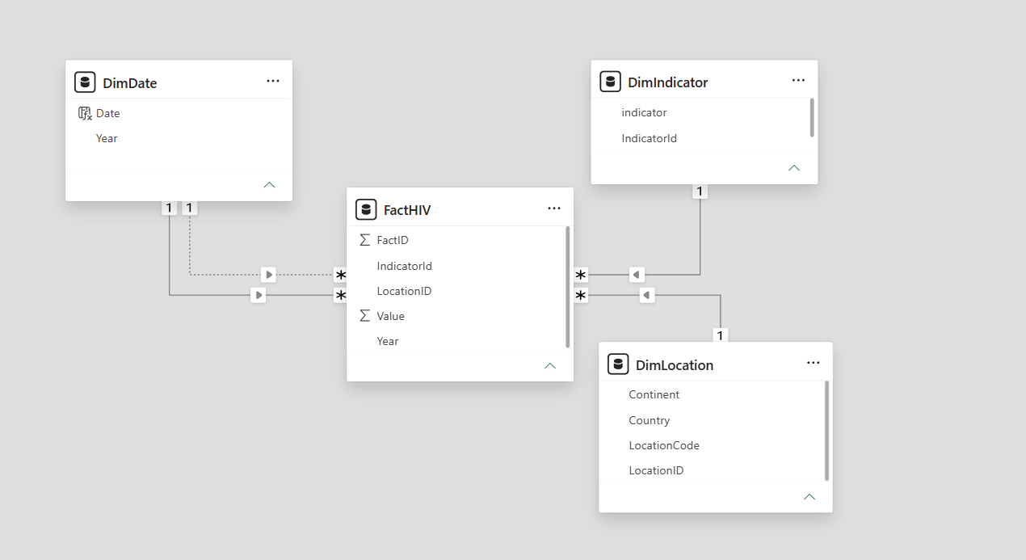
Data Modelling: Star Schema Design
FactHIV
Central fact table storing numeric HIV values.
DimDate
Supports yearly trend and YoY calculations.
DimLocation
Supports country and continent filtering.
DimIndicator
Classifies metrics such as deaths, infections and ART coverage
Fact table connected to date, location and indicator dimensions

Slide 6
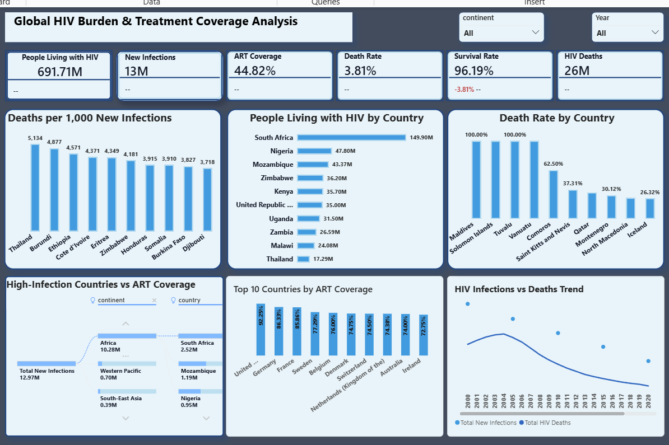
Over The Years Analysis(2000 -2004)

Slide 7
PowerBI Dashboard Overview (Current Year)

Slide 8
Key KPI Insights: 2024
KPI values from the dashboard
People living with HIV
New infections
ART coverage
35.23M
984K
66.36%
+8.14% Vs PY
+0.25% Vs PY
+2.13% Vs PY
Death rate
Survival rate
HIV deaths
1.49%
98.51%
523K
-6.44% Vs PY
+0.10% Vs PY
+1.17% Vs PY
Interpretation
Survival remains very high, but the 2024 values still show a significant global burden, with nearly one million new infections and over half a million HIV-related deaths.

Slide 9
Key Insights
Selected-country mortality insights
Trend Insight
The top four countries recorded mortality rates of 100.00%.
This may reflect small HIV population values, missing records or cases where reported deaths equal recorded people living with HIV.
Across all countries, mortality rate ranged from 26.32% to 100.00%.
Total new infections decreased by 59.02% between 2000 and 2024.
Total HIV deaths decreased by 65.50% over the same period.
New infections began a stronger downward trend from 2015, falling by 479,090 cases over nine years.
HIV deaths had their steepest decline between 2009 and 2012, dropping from 1,174,630 to 926,320.
Burden concentration
South Africa accounted for 33.50% of total people living with HIV, making it the largest contributor to burden in this analysis.

Slide 10
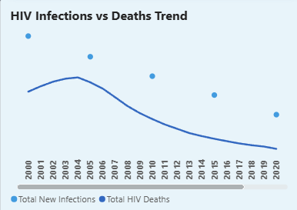
Trend Analysis
How HIV infections compare with deaths over time
Main Trend
HIV deaths and new infections generally declined over time, suggesting progress in prevention, treatment access and global HIV response.
Data quality note
Some years have missing new infection values, so isolated points appear rather than a fully continuous line.
Insight value
This visual helps compare the pace of change in infection spread and mortality impact over time.

Slide 11
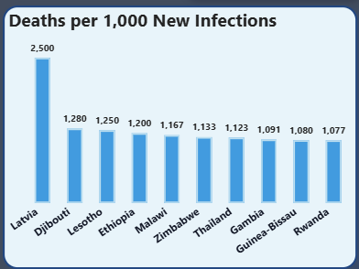
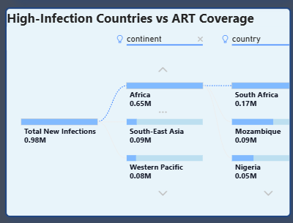
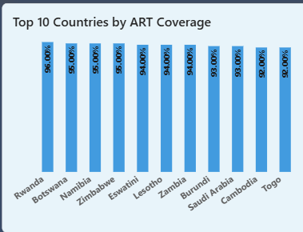
Country & Treatment Analysis(2024)
Where risk and treatment access require attention
Infection vs treatment
Mortality risk
Treatment access
Deaths per 1,000 new infections highlight countries where HIV-related deaths are high relative to new infection counts.
The decomposition tree helps assess whether high-infection countries have adequate ART coverage.
Top ART coverage countries show where treatment access is stronger and may support better survival outcomes.

Slide 12
Recommendations
Actionable steps for decision-making
1
Expand ART coverage
Prioritise countries with high infections and low treatment access.
Target high-mortality countries
2
Focus intervention resources where death rate is highest.
Reduce new infections through education, testing and prevention programmes.
3
Strengthen prevention campaigns
Improve reporting quality
Standardise country-level data collection to reduce missing values.
4
Track death rate, survival rate and YoY trends to evaluate progress.
5
Monitor annually

Slide 13
Conclusion
This report shows progress in reducing HIV infections and deaths, while also revealing country-level disparities in mortality and treatment access. Power BI helped transform multi-country HIV data into a clear dashboard for public health decision-making.
Treatment access matters, but high-risk countries still need targeted support to close gaps and reduce mortality.
Thank you!!!

